Slide 1
Language: An Introduction
Unraveling the Threads of Communication

Slide 2
What is Language?
An abstract system of communication used by humans to convey meaning through symbols, words, and sentences.

Slide 3
The Power of Language
Language shapes our world, influences behavior, and is a key marker of human cognition.

Slide 4

Language Diversity

Slide 5
The Evolution of Language
Tracing the evolutionary origins of language, from early vocalizations to modern speech.

Slide 6
Key Language Components
Exploring the building blocks of language: phonemes, morphemes, and grammar.

Slide 7
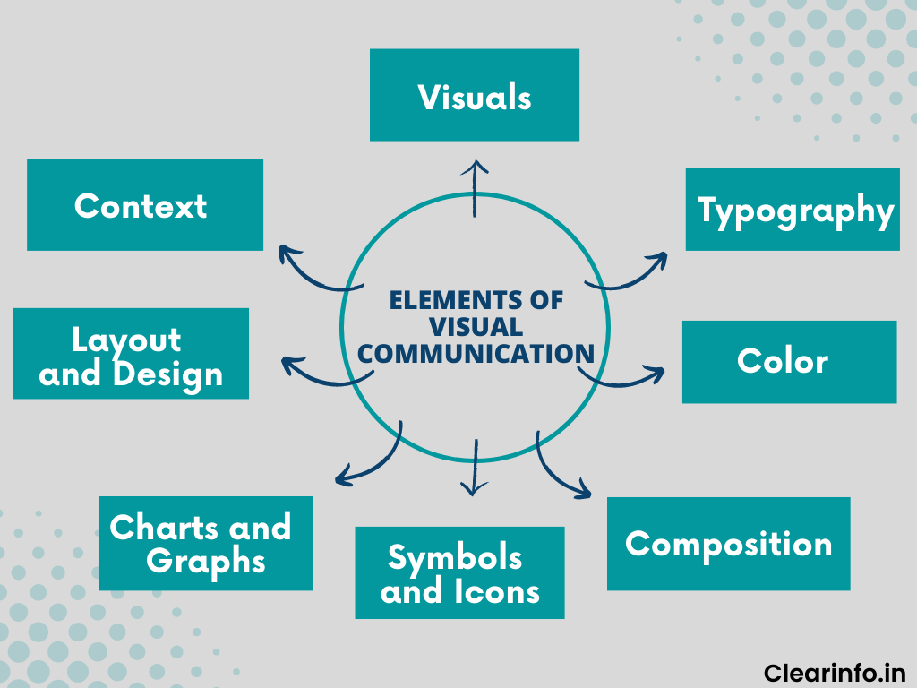
Language in Action

Slide 8
Language Acquisition
The process of learning language, from baby's first words to fluent speech, and its crucial role in child development.

Slide 9
Cross-Cultural Communication
Challenges and insights into communicating across different languages and cultures.

Slide 10
Conclusion

Slide 11
Summary & Next Steps
This presentation covered key aspects of language.
Next Steps:
1. Review the content.
2. Prepare supporting materials.
3. Engage with your audience!

